Slide 1

Case Studies
Learning Objectives:
Implement the basic building blocks of ResNets in a deep neural network using Keras.
Train a state-of-the-art neural network for image classification.
Implement a skip connection in your network.
Create a dataset from a directory.
Preprocess and augment data using the Keras Sequential API.
Adapt a pretrained model to new data and train a classifier using the Functional API and MobileNet.
Fine-tine a classifier's final layers to improve accuracy

Slide 2
Case Studies
1 Why look at case studies?
2 Classic networks
3 Residual Networks (ResNets)
4 Why ResNets work
5 Network in Network and 1×1 convolutions
6 Inception network motivation
7 Inception network
8 MobileNet
9 MobileNet Architecture
10 EfficientNet
11 Transfer Learning
12 Data augmentation
13 The state of computer vision

Slide 3
Case Studies
Why look at case studies?

Slide 4
Why look at case studies?
The past few years of computer vision research have been focused on how to put together the basic building blocks of convolutional layers, pooling layers, and fully connected layers to form effective convolutional neural networks. By looking at case studies of effective networks, one can gain insights and ideas that could be useful for their own work, even if they are not working on computer vision tasks.
Several classic networks that have been successful in computer vision, including LeNet-5, AlexNet, VGG, ResNet, and Inception, and explains that these networks can be used as templates or starting points for one's own work.
The ideas from these networks are cross-fertilizing and making their way into other disciplines.

Slide 5
Outline
Classic networks:
LeNet-5
AlexNet
VGG
ResNet
Inception

Slide 6
Case Studies
Classic networks

Slide 7
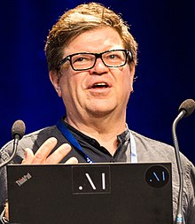
LeNet - 5
Lenet-5 is one of the earliest pre-trained models proposed by Yann LeCun and others in the year 1998, in the research paper Gradient-Based Learning Applied to Document Recognition. They used this architecture for recognizing the handwritten and machine-printed characters.
The main reason behind the popularity of this model was its simple and straightforward architecture. It is a multi-layer convolution neural network for image classification
The architecture consists of a series of convolutional and pooling layers followed by fully connected layers and a final output layer. As you go deeper into the network, the height and width of the volumes decrease, while the number of channels increases.

Slide 8
LeNet - 5
It takes a grayscale image as input. Once we pass it through a combination of convolution and pooling layers, the output will be passed through fully connected layers and classified into corresponding classes. The total number of parameters in LeNet-5 are:
- Parameters: 60k
- Layers flow: Conv -> Pool -> Conv -> Pool -> FC -> FC -> Output
- Activation functions: Sigmoid/tanh and ReLu

Slide 9



LeNet - 5
⋮
⋮
avg pool
avg pool
FC
FC
5 × 5
s = 1
f = 2
s = 2
5 × 5
s = 1
f = 2
s = 2
32×32 ×1
28×28×6
14×14×6
10×10×16
5×5×16
120
84
Architecture of the Lenet-5

Slide 10
AlexNet
Alexnet was proposed in 2012 in the research paper named Imagenet Classification with Deep Convolution Neural Network by Alex Krizhevsky and his colleagues.
In this model, the depth of the network was increased in comparison to Lenet-5.
It was designed for image classification tasks and had a similar architecture to LeNet-5, with a series of convolutional and pooling layers followed by fully connected layers and a final output layer:
- Parameters: 60 million
- Activation function: ReLu
AlexNet used the value activation function, which was a major improvement over the sigmoid and tanh nonlinearities used at the time.

Slide 11
AlexNet
AlexNet architecture:
It has 8 layers with learnable parameters.
The input to the Model is RGB images.
It has 5 convolution layers with a combination of max-pooling layers.
Then it has 3 fully connected layers.
The activation function used in all layers is Relu.
It used two Dropout layers.
The activation function used in the output layer is Softmax.
The total number of parameters in this architecture is 62.3 million.

Slide 12
AlexNet
MAX-POOL
MAX-POOL
11 × 11
s = 4
3 × 3
s = 2
5 × 5
same
3 × 3
s = 2
55×55 ×96
27×27 ×96
27×27 ×256
13×13 ×256
227×227 ×3
⋮
⋮
⋮
MAX-POOL
=
3 × 3
same
13×13 ×384
3 × 3
3 × 3
3 × 3
s = 2
Softmax 1000
13×13 ×384
13×13 ×256
6×6 ×256
9216
4096
4096
Architecture of the AlexNet

Slide 13
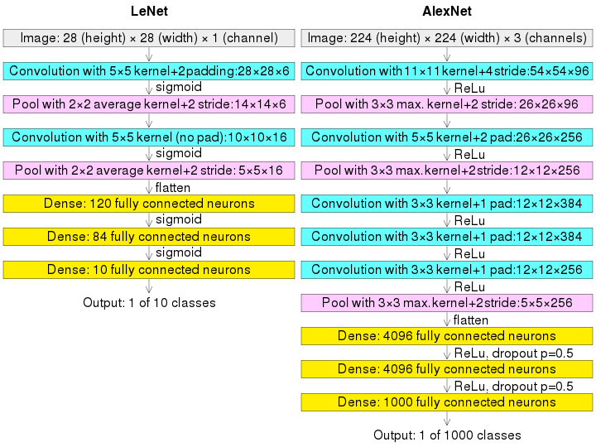
AlexNet

Slide 14
VGG - 16
VGG -16 was proposed by Karen Simonyan and Andrew Zisserman of the Visual Geometry Group Lab of Oxford University in 2014 in the paper “VERY DEEP CONVOLUTIONAL NETWORKS FOR LARGE-SCALE IMAGE RECOGNITION”.
It was designed for the ImageNet Large Scale Visual Recognition Challenge, which is an annual competition to recognize objects in images from a thousand different categories.
VGG-16 is a deep CNN architecture that consists of 16 layers, including 13 convolutional layers, 5 max pooling layers, and 3 fully connected layers. The input to the network is an RGB image of size 224x224.

Slide 15
VGG - 16
MAX-POOL = 2×2 , s = 2
CONV = 3×3 filter, s = 1, same
224×224×64
112×112 ×64
112×112 ×128
56×56 ×128
[CONV 64]
×2
POOL
[CONV 128]
×2
POOL
224×224 ×3
56×56 ×256
28×28 ×256
28×28 ×512
14×14×512
[CONV 256]
×3
POOL
[CONV 512]
×3
POOL
14×14 ×512
7×7×512
FC 4096
FC 4096
Softmax 1000
[CONV 512]
×3
POOL

Slide 16
VGG - 16
VGG-16 achieved state-of-the-art performance on the ImageNet Large Scale Visual Recognition Challenge, and its architecture has been widely adopted and used as a basis for many other CNNs. Its deep architecture and small filter sizes have been shown to be effective for extracting meaningful features from images, even in cases where the images are highly varied or complex.

Slide 17
Case Studies
Residual Networks (ResNets)

Slide 18
Residual Networks (ResNets)
The ResNet architecture was proposed in 2015 by Kaiming He, Xiangyu Zhang, Shaoqing Ren, and Jian Sun, who were researchers at Microsoft at the time. They introduced the architecture in their paper titled "Deep Residual Learning for Image Recognition," which was published in the Proceedings of the IEEE Conference on Computer Vision and Pattern Recognition (CVPR).
ResNets were designed to address the problem of vanishing gradients in very deep CNNs.
The key innovation in ResNets is the use of residual connections, which allow the network to learn residual functions rather than directly learning the underlying mapping. A residual connection is simply a shortcut connection that skips one or more layers and adds the output of the skipped layers to the output of the subsequent layers.

Slide 19
Residual block
The ResNet architecture consists of several blocks, each of which contains multiple residual units. A residual unit consists of two convolutional layers with batch normalization and ReLU activation, followed by a residual connection that adds the output of the first convolutional layer to the output of the second convolutional layer.
Many residual blocks can be stacked together to form a deep network. When compared to plain networks, which do not have skip connections, ResNets enable the training of much deeper neural networks without any appreciable loss in performance. In plain networks, as the number of layers increases, the training error tends to decrease initially but then starts increasing.
On the other hand, ResNets enable the performance of the training error to keep decreasing even as the number of layers gets deeper.

Slide 20


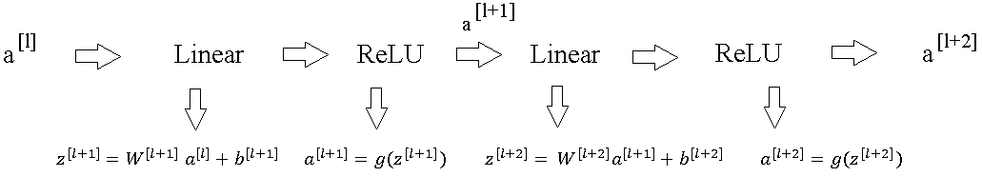
Residual block
![#%(]
![#]
![#%&]

Slide 21
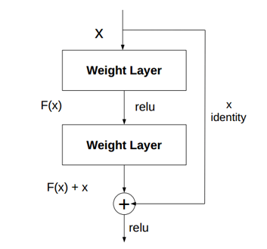
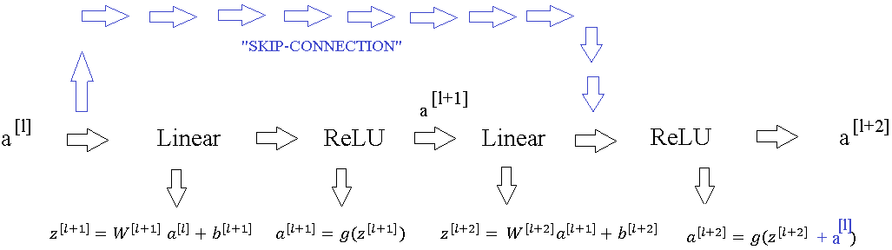
Residual block

Slide 22
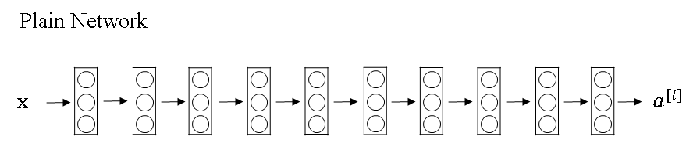
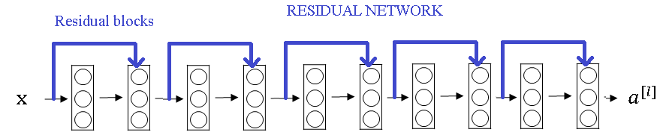
Residual block

Slide 23
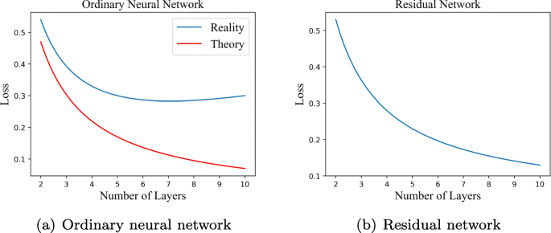
Residual Network
Plain
ResNet
training error
training error
# layers
# layers

Slide 24
Residual Networks (ResNets)
ResNets work so well because they help with the vanishing and exploding gradient problems in very deep neural networks.
The ResNet architecture has been shown to achieve state-of-the-art performance on many computer vision tasks, including image classification, object detection, and semantic segmentation. It has also been used as a backbone for other architectures, such as Faster R-CNN and Mask R-CNN, which are used for object detection and instance segmentation tasks, respectively.
Overall, ResNets have been an important development in the field of deep learning, allowing researchers to train deeper and more powerful neural networks for a wide range of computer vision tasks.
Although ResNets are effective at training very deep networks, it is unclear whether they will keep helping as the number of layers increases further.

Slide 25
Case Studies
Why ResNets
work

Slide 26
Why ResNets work
Residual Networks, or ResNets, work so well because it is easy for the extra layers to learn the identity function, allowing the network to make use of more layers without hurting performance.
The addition of a skip connection in a residual block allows the activation output to be equal to the activation input, which is necessary for the identity function to be learned. This addition also requires same convolutions to preserve the dimensionality of the output and input vectors. The ResNet architecture involves using multiple convolutional layers, occasional pooling layers, and a fully connected layer at the end for prediction. One key idea behind ResNets is using one by one convolutions, which will be discussed in the next section.

Slide 27
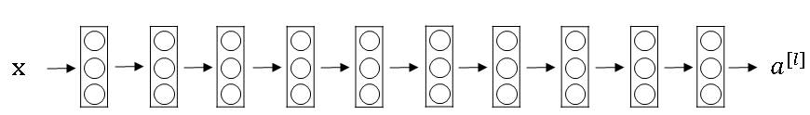
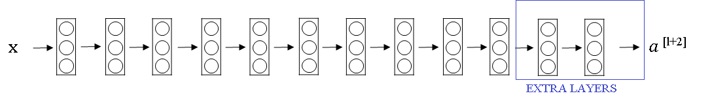
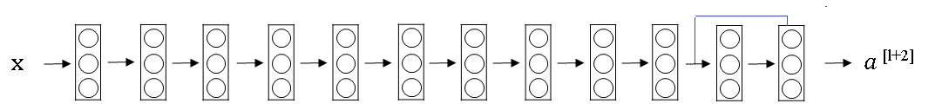
Why do residual networks work?

Slide 28
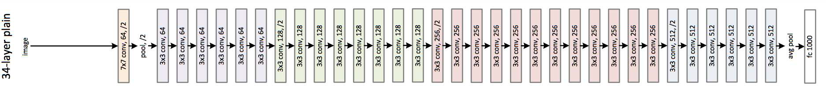
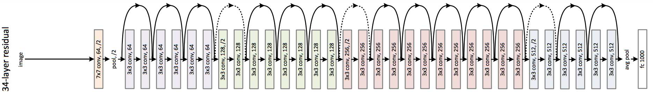
ResNet
Plain
ResNet

Slide 29
Case Studies
Network in Network and 1×1 convolutions

Slide 30
Why does a 1 × 1 convolution do?
A one-by-one convolution is a type of convolutional layer that uses a filter with dimensions 1x1xN, where N is the number of channels in the input volume. While it may seem trivial, it applies a fully connected neural network to each position in the input volume, outputting a single value. This can perform a non-trivial computation and the output volume has the same height and width as the input volume but may have a different number of channels.
Notes:
A one-by-one convolution is a convolutional layer that uses a filter with dimensions 1x1xN, where N is the number of channels in the input volume. It seems like a trivial operation as it simply multiplies each element in the input volume by a scalar, but when applied to a volume with multiple channels, it can perform a non-trivial computation.
Specifically, a one-by-one convolution applies a fully connected neural network to each position in the input volume, with each network taking as input the values of all the channels at that position and outputting a single value. The output volume of a one-by-one convolution has the same height and width as the input volume, but the number of channels can be different.

Slide 31
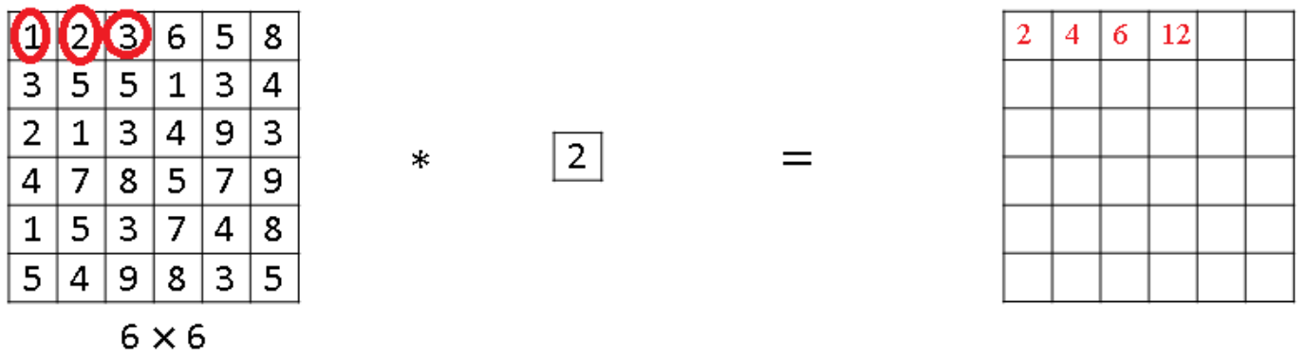
Why does a 1 × 1 convolution do?
We have a 1x1 filter, we'll put in number two there, and if you take 6x6x1 input and convolve it with this filter, you end up just taking the image and multiplying it by two.

Slide 32
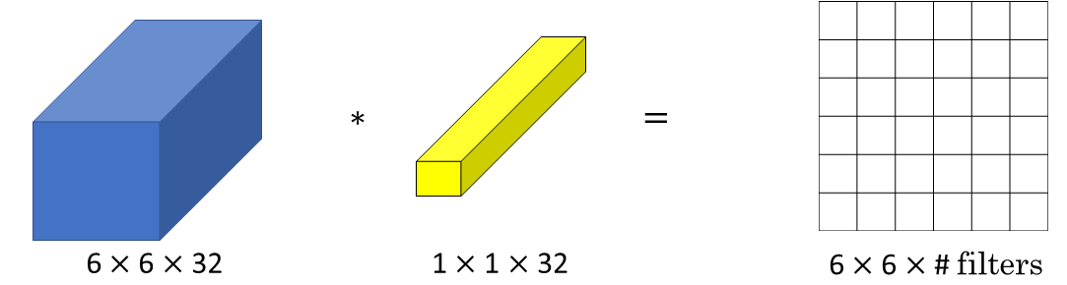
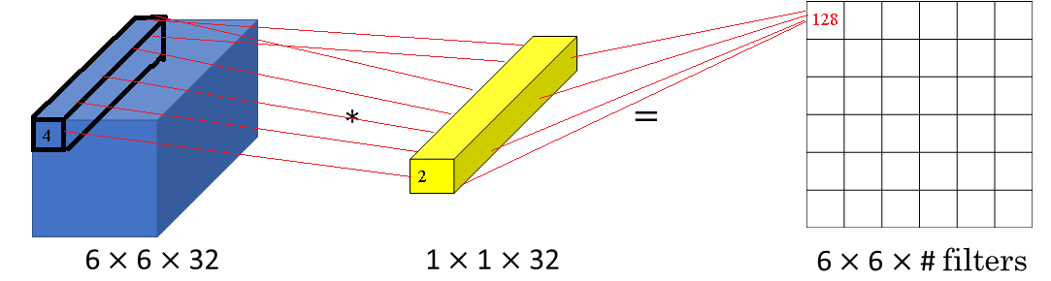
Why does a 1 × 1 convolution do?

Slide 33
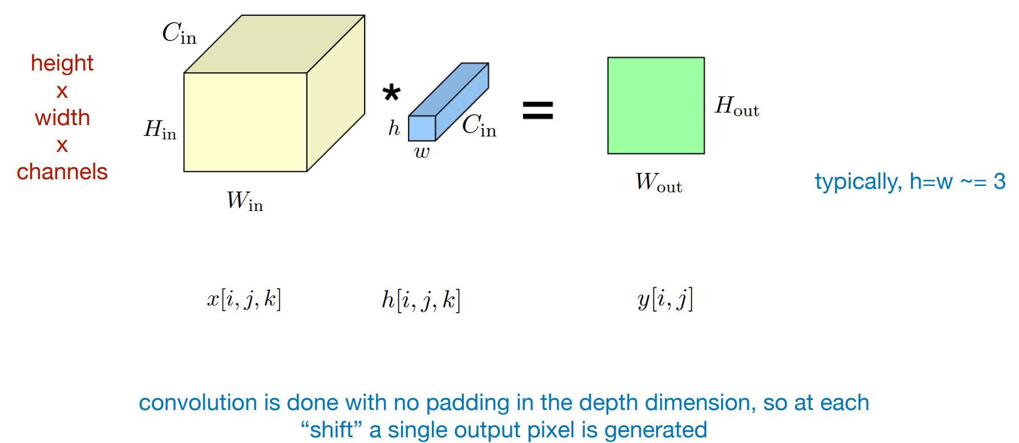
Why does a 1 × 1 convolution do?

Slide 34
Using 1×1 convolutions
One way to use a one-by-one convolution is to shrink the number of channels in an input volume. For example, if you have a 28x28x192 volume and you want to shrink it to a 28x28x32 volume, you can use 32 one-by-one filters to compute the output volume.
The one-by-one convolution operation has non-linearity, which allows it to learn a more complex function of the input volume by adding another layer. One-by-one convolutions have been used in many neural network architectures, including the inception network, which we'll see in the next video.

Slide 35

Using 1×1 convolutions
ReLU
CONV 1 × 1
28 × 28 × 32
28 × 28 × 192

Slide 36
Case Studies
Inception network
motivation

Slide 37
Motivation for inception network
The Inception network is a convolutional neural network that uses multiple filter sizes and pooling layers in a single layer, allowing the network to learn the most effective combinations for each layer. The bottleneck layer is introduced to reduce the dimensionality of the input before applying a larger filter size, reducing computational cost while maintaining performance. It was proposed by Christian Szegedy at Google and has achieved state-of-the-art performance on image recognition tasks, influencing many other CNN architectures.
Notes:
The inception network is a convolutional neural network architecture that uses multiple filter sizes and pooling layers in a single layer, rather than having to pick one filter size or pooling layer for each layer of the network.
This allows the network to learn the most effective combinations of filter sizes and pooling layers for each layer.
However, this also results in a higher computational cost. To address this issue, the inception module introduces the idea of a bottleneck layer, which uses a 1x1 convolution to reduce the dimensionality of the input before applying a larger filter size. This reduces the computational cost significantly without compromising the performance of the network.
The inception network is named after the idea of going "back to the inception" of neural network design, and it was first proposed by Christian Szegedy and his team at Google. The inception network has been shown to achieve state-of-the-art performance on image recognition tasks, and it has influenced many other convolutional neural network architectures.

Slide 38
Motivation for inception network
1 × 1
3 × 3
64
5 × 5
28
128
32
32
28
28 × 28 × 192
MAX-POOL

Slide 39
The problem of computational cost
CONV 5 × 5,
same, 32
28 × 28 × 32
28 × 28 × 192

Slide 40
Using 1×1 convolution
CONV 1 × 1,
16,
1 × 1 × 192
CONV 5 × 5,
32,
5 × 5 × 16
28 × 28 × 16
28 × 28 × 32
28 × 28 × 192

Slide 41
Case Studies
Inception network

Slide 42
Inception module
The Inception module is a building block used in the Inception network, a convolutional neural network architecture designed for image recognition tasks.
The module takes as input the activation output from some previous layer and applies a combination of 1x1, 3x3, and 5x5 convolutions, as well as pooling layers, to the input.
The output of each convolutional layer is then concatenated along the channel dimension to form the output of the Inception module. The Inception module allows the network to learn the most effective combinations of filter sizes and pooling layers for each layer, and has been shown to achieve state-of-the-art performance on image recognition tasks.

Slide 43
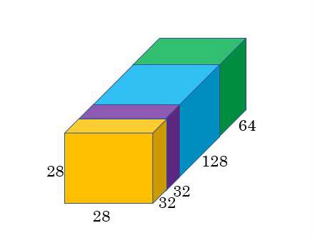
Inception module
1 × 1
CONV
1 × 1
CONV
3 × 3
CONV
Previous Activation
Channel Concat
1 × 1
CONV
5 × 5
CONV
MAXPOOL 3 × 3,s = 1
same
1 × 1
CONV

Slide 44
Inception network
The Inception network was developed by Google and was named after a meme from the movie Inception. There are newer versions of the Inception algorithm, such as Inception v2, v3, and v4, and these are built on the same basic idea of the Inception module.
The Inception network is composed of a lot of repeated blocks, which are basically the inception modules repeated in different positions of the network.
The last few layers of the network consist of a fully connected layer followed by a softmax layer to make a prediction. The additional side-branches take some hidden layer and use it to make a prediction, which helps ensure that the features computed in the intermediate layers are not too bad for predicting the output. This has a regularizing effect on the Inception network and helps prevent it from overfitting.

Slide 45
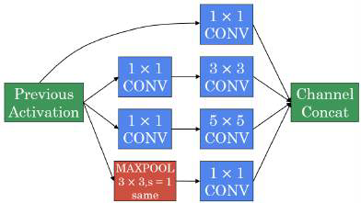
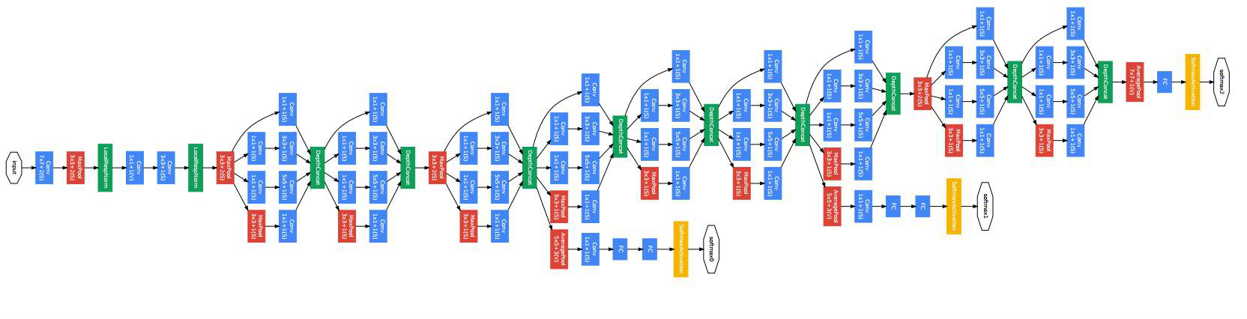
Inception network

Slide 46


Slide 47
Convolutional Neural Networks
MobileNet

Slide 48
Motivation for MobileNets
MobileNet is a convolutional neural network architecture designed for efficient processing on mobile devices and embedded systems. It was developed by Andrew G. Howard, Menglong Zhu, Bo Chen, Dmitry Kalenichenko, Weijun Wang, Tobias Weyand, Marco Andreetto, and Hartwig Adam from Google.
MobileNet uses depthwise separable convolutions, which split a standard convolution into two separate operations: a depthwise convolution that applies a single filter to each input channel, and a pointwise convolution that applies a 1x1 filter to the output of the depthwise convolution to combine the channels. This reduces the number of computations required and results in a more efficient network with fewer parameters, while still achieving good accuracy on image recognition tasks.
MobileNet has been used in a variety of applications, including object detection, face recognition, and image segmentation, and has become a popular choice for computer vision tasks on mobile devices and other resource-constrained environments.

Slide 49

Motivation for MobileNets
Low computational cost at deployment
Useful for mobile and embedded vision applications
Key idea: Normal vs. depthwise- separable convolutions

Slide 50
Normal Convolution
Where an input image is convolved with a filter to produce an output feature map. The computational cost of this operation is proportional to the number of filter parameters, the number of filter positions, and the number of filters.

Slide 51
Normal Convolution
x
*
=
3 x 3 x 3
4 x 4
f x f x n_{c}
6 x 6 x 3
n x n x n_{c}
Notes:
In the normal convolution, you may have an input image that is some n by n by n_c, where n_c is the number of channels. Six by six by three channels in this case, and you want to convolve it with a filter that is f by f by n_c, and in this case is three by three by three.

Slide 52
Normal Convolution
x
*
=
3 x 3 x 3
4 x 4
f x f x n_{c}
6 x 6 x 3
n x n x n_{c}
Notes:
The way you do this is you would take this filter which I'm going to draw as a three-dimensional yellow block and put the yellow filter over there. There are 27 multiplications you have to do, sum it up, and then that gives you this value. Then shift a filter over, multiply the 27 pairs of numbers, add that up that gives you this number, and you keep going to get this, to get this, and then this, and so on, until you have computed all four by four output values.

Slide 53
Normal Convolution
x
x
*
=
3 x 3 x 3
4 x 4
f x f x n_{c}
6 x 6 x 3
n x n x n_{c}
Notes:
The way you do this is you would take this filter which I'm going to draw as a three-dimensional yellow block and put the yellow filter over there. There are 27 multiplications you have to do, sum it up, and then that gives you this value. Then shift a filter over, multiply the 27 pairs of numbers, add that up that gives you this number, and you keep going to get this, to get this, and then this, and so on, until you have computed all four by four output values.

Slide 54
Normal Convolution
x
x
x
*
=
3 x 3 x 3
4 x 4
f x f x n_{c}
6 x 6 x 3
n x n x n_{c}
Notes:
The way you do this is you would take this filter which I'm going to draw as a three-dimensional yellow block and put the yellow filter over there. There are 27 multiplications you have to do, sum it up, and then that gives you this value. Then shift a filter over, multiply the 27 pairs of numbers, add that up that gives you this number, and you keep going to get this, to get this, and then this, and so on, until you have computed all four by four output values.

Slide 55
Normal Convolution
x
x
x
x
*
=
3 x 3 x 3
4 x 4
f x f x n_{c}
6 x 6 x 3
n x n x n_{c}
Notes:
The way you do this is you would take this filter which I'm going to draw as a three-dimensional yellow block and put the yellow filter over there. There are 27 multiplications you have to do, sum it up, and then that gives you this value. Then shift a filter over, multiply the 27 pairs of numbers, add that up that gives you this number, and you keep going to get this, to get this, and then this, and so on, until you have computed all four by four output values.

Slide 56
Normal Convolution
x
x
x
x
*
=
x
x
x
x
x
x
x
x
x
x
x
x
3 x 3 x 3
4 x 4
6 x 6 x 3
n x n x n_{c}
Notes:
The way you do this is you would take this filter which I'm going to draw as a three-dimensional yellow block and put the yellow filter over there. There are 27 multiplications you have to do, sum it up, and then that gives you this value. Then shift a filter over, multiply the 27 pairs of numbers, add that up that gives you this number, and you keep going to get this, to get this, and then this, and so on, until you have computed all four by four output values.

Slide 57
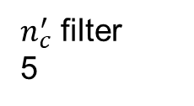
Normal Convolution
$n_{c}^{′}$ filter
5
x
x
x
x
*
=
x
x
x
x
x
x
x
x
x
x
x
x
3 x 3 x 3
4 x 4
f x f x n_{c}
n_{out} x n_{out}
6 x 6 x 3
n x n x n_{c}
Notes:
We didn't use padding in this case, and we use a stride of one, which is why the output size a n out by a n out is a bit smaller than the input size. That is this four by four instead of six by six.

Slide 58

Normal Convolution
$n_{c}^{′}$ filter
5
*
=
x
x
x
x
x
x
x
x
x
x
x
x
3 x 3 x 3
x
x
x
x
f x f x n_{c}
4 x 4 x 5
6 x 6 x 3
n_{out} x n_{out} x $n_{c}^{′}$
n x n x n_{c}
Computational cost
=
#filter params
x # filter positions
x
# of filters
2160
3 x 3 x 3
4 x 4
x
5
Notes:
Rather than just having one of these three by three by three filters, you may have some n_c prime filters and if you have five of them, then the output will be four by four by five, or a n out by a n out by n_c prime.
Total number of computations needed to compute this output is given by the number of filter parameters which is three by three by three in this case, multiplied by the number of filter positions. That is a number of places where we place this big yellow block, which is four by four, and then multiplied by the number of filters, which is five in this case. You can check for yourself that this is the total number of multiplications we need to do, because at each of the locations we plopped down the filter, we need to do this many multiplications, and then we have this many filters. If you multiply these numbers out, this turns out to be 2,160

Slide 59
Depthwise Separable Convolution
The depthwise separable convolution can be used as a building block for the MobileNet architecture, which can achieve significant computational efficiency while maintaining high accuracy in image classification tasks.

Slide 60
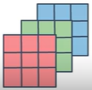
Depthwise Separable Convolution
*
=
Depthwise Separable Convolution
*
*
=
Depthwise
Pointwise

Slide 61
Depthwise Convolution
*
=
3 x 3
4 x 4 x 3
6 x 6 x 3

Slide 62
Depthwise Convolution
X
*
=
3 x 3
4 x 4 x 3
6 x 6 x 3

Slide 63
Depthwise Convolution
X
X
*
=
3 x 3
4 x 4 x 3
6 x 6 x 3

Slide 64
Depthwise Convolution
X
X
X
*
=
3 x 3
4 x 4 x 3
6 x 6 x 3

Slide 65
Depthwise Convolution
X
X
X
X
*
=
3 x 3
4 x 4 x 3
6 x 6 x 3

Slide 66
Depthwise Convolution
X
X
X
X
*
=
X
X
X
X
X
X
X
X
X
X
X
X
3 x 3
4 x 4 x 3
6 x 6 x 3

Slide 67
Depthwise Convolution
X
X
X
X
X
*
=
X
X
X
X
X
X
X
X
X
X
X
X
3 x 3
4 x 4 x 3
6 x 6 x 3

Slide 68
Depthwise Convolution
X
X
X
X
X
X
*
=
X
X
X
X
X
X
X
X
X
X
X
X
3 x 3
4 x 4 x 3
6 x 6 x 3

Slide 69
Depthwise Convolution
X
X
X
X
X
X
X
*
=
X
X
X
X
X
X
X
X
X
X
X
X
3 x 3
4 x 4 x 3
6 x 6 x 3

Slide 70
Depthwise Convolution
X
X
X
X
X
X
X
X
*
=
X
X
X
X
X
X
X
X
X
X
X
X
3 x 3
4 x 4 x 3
6 x 6 x 3

Slide 71
Depthwise Convolution
X
X
X
X
X
X
X
X
X
*
=
X
X
X
X
X
X
X
X
X
X
X
X
X
X
3 x 3
4 x 4 x 3
6 x 6 x 3

Slide 72
Depthwise Convolution
X
X
X
X
X
X
X
X
X
X
X
X
X
X
*
=
X
X
X
X
X
X
X
X
X
X
X
X
X
X
X
X
3 x 3
4 x 4 x 3
6 x 6 x 3

Slide 73
Depthwise Convolution
X
X
X
X
X
X
X
X
X
X
X
X
X
X
*
=
X
X
X
X
X
X
X
X
X
X
X
X
X
X
X
X
3 x 3
4 x 4 x 3
f x f
n_{out} x n_{out} x n_{c}
6 x 6 x 3
n x n x n_{c}
Computational cost
=
#filter params
x # filter positions
x
# of filters
432
3 x 3
4 x 4
x
3

Slide 74
Depthwise Separable Convolution
Depthwise Convolution
*
=
432
Pointwise Convolution
*
=
4 x 4 x 3
4 x 4 x 5

Slide 75
Pointwise Convolution
The pointwise convolution step involves convolving the intermediate feature maps with a set of 1x1 filters. The computational cost of this operation is proportional to the number of filter parameters, the number of filter positions, and the number of output channels.

Slide 76
Pointwise Convolution
X
*
=
1 x 1 x 3
^{4 x 4}
4 x 4 x 3

Slide 77
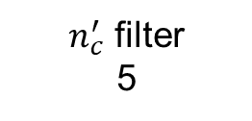
Pointwise Convolution
$n_{c}^{′}$ filter
5
X
X
X
X
*
=
X
X
X
X
X
X
X
X
X
X
X
X
1 x 1 x 3
^{4 x 4}
4 x 4 x 3
1 x 1 x n_{c}
n_{out} x n_{out} x n_{c}

Slide 78

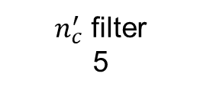
Pointwise Convolution
$n_{c}^{′}$ filter
5
*
=
X
X
X
X
X
X
X
X
X
X
X
X
1 x 1 x 3
X
X
X
X
4 x 4 x 3
1 x 1 x n_{c}
^{4 x 4 x 5}
n_{out} x n_{out} x $n_{c}^{′}$
n_{out} x n_{out} x n_{c}
Computational cost
=
#filter params
x # filter positions
x
# of filters
240
1 x 1 x 3
4 x 4
x
5

Slide 79
Depthwise Separable Convolution
Normal Convolution
*
=
4 x 4 x 5
Depthwise Separable Convolution
*
*
=
Depthwise
Pointwise

Slide 80
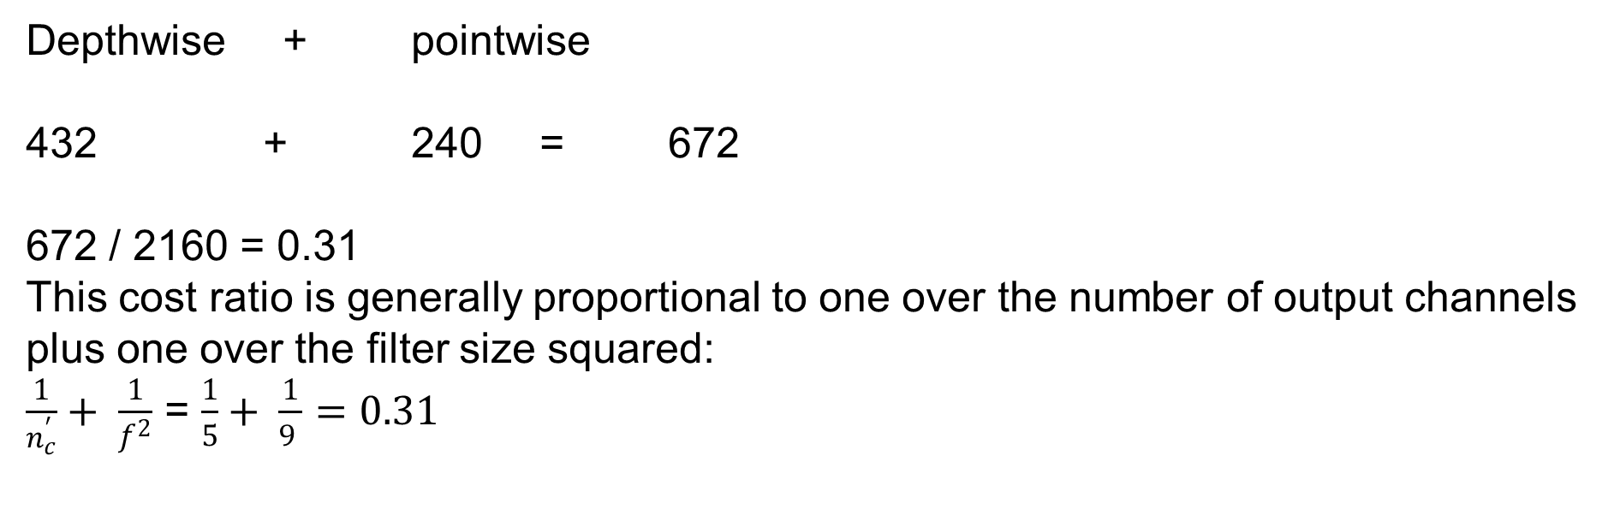
Cost Summary
Cost of normal convolution: 2160
Cost of depthwise separable convolution:
Depthwise + pointwise
+ 240 = 672
672 / 2160 = 0.31
This cost ratio is generally proportional to one over the number of output channels plus one over the filter size squared:
$\frac{1}{n_{c}^{′}}+ \frac{1}{f^{2}}$ = $\frac{1}{5}+ \frac{1}{9 }=0.31$
Notes:
This method significantly reduces computational costs compared to traditional convolutions. For instance, in a specific example, the depthwise separable convolution was about 31% as computationally expensive as a normal convolution, showcasing its efficiency. The authors of the MobileNets paper demonstrated that this cost ratio is generally proportional to one over the number of output channels plus one over the filter size squared. This efficient building block is crucial in constructing MobileNet, enabling effective deployment in resource-constrained scenarios.

Slide 81

Depthwise Separable Convolution
Depthwise Convolution
6 x 6 x n_{c}
*
=
3 x 3 x n_{c}
4 x 4 x 3
Pointwise Convolution
*
=
4 x 4 x 3
4 x 4 x 5
n_{out} x n_{out} x $n_{c}^{′} (5)$

Slide 82

Depthwise Separable Convolution
Depthwise Convolution
*
=
6 x 6 x n_{c}
3 x 3 x n_{c}
4 x 4 x n_{c}
Pointwise Convolution
*
=
1 x 1 x n_{c}
4 x 4 x 8
4 x 4 x n_{c}
n_{out} x n_{out} x $n_{c}^{′} (8)$

Slide 83
Convolutional Neural Networks
MobileNet Architecture

Slide 84
MobileNet
The main idea behind MobileNet is to replace expensive convolutional operations with less expensive depthwise separable convolutional operations, which consist of a depthwise convolution operation followed by a pointwise convolution operation.
In MobileNet v1, this idea is implemented using a block that includes a depthwise convolutional operation and a stack of 13 of these layers in order to go from the original raw input image to make a classification prediction.

Slide 85

MobileNet
MobileNet v1
MobileNet v2
Residual Connection
Expansion
Depthwise
Projection

Slide 86
MobileNet v2 Bottleneck
In MobileNet v2, there are two main changes:
One is the addition of a residual connection, similar to ResNet, which takes the input from the previous layer and sums it or passes it directly to the next layer, allowing gradients to propagate backward more efficiently.
The second change is the addition of an expansion layer before the depthwise convolution, followed by the pointwise convolution, which is called projection in MobileNet v2. The expansion layer increases the dimension of the input by a factor of six, while the projection layer reduces it back down to a smaller set of values, thus enabling a richer set of computations while keeping the memory requirements relatively small.

Slide 87
MobileNet v2 Bottleneck
Residual Connection
Expansion
Depthwise
Pointwise

Slide 88
MobileNet
MobileNet v1
MobileNet v2
Residual Connection
Expansion
Depthwise
Projection

Slide 89
MobileNet v2 Full Architecture
The bottleneck block in MobileNet v2 uses the expansion operation to increase the size of the representation within the bottleneck block, allowing the neural network to learn a richer function. The pointwise convolution or projection operation is used to project it back down to a smaller set of values, reducing the memory requirements. The MobileNet v2 architecture repeats this bottleneck block 17 times and ends with a pooling layer, a fully connected layer, and a softmax layer to generate the classification output.
MobileNet v2 achieves better performance than MobileNet v1 while continuing to use only a modest amount of compute and memory resources. If you are interested in building efficient neural networks, the video also briefly mentions the concept of efficient nets as another useful idea to learn about.

Slide 90

MobileNet v2 Full Architecture
conv2d
1 x 1
avgpool 7 x 7
conv2d 1 x 1
conv2d

Slide 91
Convolutional Neural Networks
EfficientNet

Slide 92
EfficientNet
With MobileNet, you can build computationally efficient neural networks by using depthwise separable convolutions and bottleneck blocks. With EfficientNet, you can adapt your network to a specific device, allowing you to build neural networks for mobile and embedded devices, where computation and memory are limited.
EfficientNet is a convolutional neural network architecture developed by Mingxing Tan and Quoc V. Le at Google. It was designed to achieve state-of-the-art accuracy on image classification tasks while minimizing the number of parameters and computational resources needed.

Slide 93
EfficientNet
EfficientNet is a method that enables scaling of a neural network for a specific device, based on its computational budget. It uses compound scaling to simultaneously scale up or down the resolution of the image, the depth, and the width of the neural network. The goal is to choose the optimal values of these parameters to get the best possible performance.
EfficientNet provides an open-source implementation to help find the right balance between these factors and optimize performance.
Notes:
EfficientNet is an approach that enables you to scale up or down a neural network for a specific device, based on its computational budget. The three things you can do to scale a network are to use a high resolution image (denoted as r), increase the depth of the network (denoted as d), or widen the layers (denoted as w). Given a particular computational budget, you need to choose the optimal values of r, d, and w to get the best possible performance. The challenge is to determine the rate at which to scale each of these parameters.
EfficientNet uses compound scaling to simultaneously scale up or down the resolution of the image, the depth, and the width of the neural network.
However, it is important to find the right balance between these factors to optimize performance. EfficientNet provides an open-source implementation to help you choose the best trade-off between r, d, and w.

Slide 94
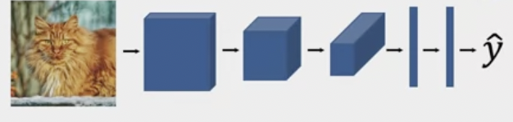
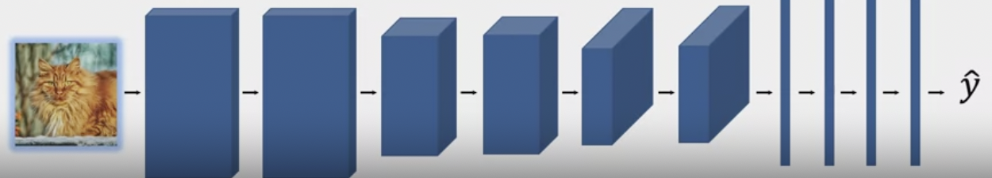
EfficientNet
Baseline
Compound scaling

Slide 95
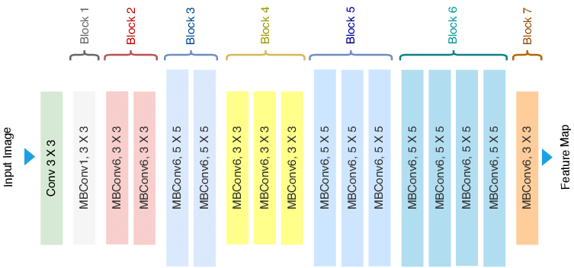
EfficientNet

Slide 96
Practical advice for using ConvNets
Transfer Learning

Slide 97
Transfer Learning
Transfer learning is a technique in computer vision that enables faster progress by using pre-trained neural network models. Instead of starting from scratch, pre-trained models' weights can be used as a starting point for a new model, which is useful when working with small training sets or limited computational resources.
Pre-trained models, which are available for free, have been trained on large data sets such as ImageNet, MS COCO, and Pascal. The early layers of the pre-trained model are usually frozen, and the later layers are fine-tuned to the specific problem.
Notes:
Transfer learning is a technique that can be used in computer vision applications to make faster progress by leveraging pre-trained neural network models. Instead of starting from scratch with random initialization, transfer learning allows you to use weights from a pre-trained model as a starting point for your own model. This is especially useful when working with small training sets or limited computational resources.
There are many open-source neural network models available that have been pre-trained on large data sets, such as ImageNet, MS COCO, and Pascal. You can download these models and use them as initialization for your own model. Typically, the early layers of the pre-trained model are frozen, meaning their weights are not updated during training, while the later layers are fine-tuned to your specific problem.

Slide 98
Transfer Learning
Transfer learning is a technique in computer vision that uses pre-trained neural network models to accelerate progress by using their weights as a starting point for your own model.
The early layers of the pre-trained model are typically frozen, while the later layers are fine-tuned to your specific problem.
The number of layers that are frozen and fine-tuned depends on the size of your training set, and pre-computing activations for the frozen layers can speed up training.
Overall, transfer learning is a powerful technique that can save time and improve performance in computer vision applications.
Notes:
The number of layers you freeze and fine-tune depends on the size of your training set. If you have a small training set, you may want to freeze more layers and fine-tune fewer. If you have a larger training set, you may be able to fine-tune more layers.
Another technique that can be used to speed up training is pre-computing activations for the frozen layers and saving them to disk. This way, you don't need to recompute the activations every time you run an epoch or pass through the training set.
In summary, transfer learning is a powerful technique that can save time and improve performance in computer vision applications. It allows you to leverage pre-trained models and fine-tune them to your specific problem. By freezing and fine-tuning different layers, you can adapt the model to your specific needs, depending on the size of your training set and computational resources.

Slide 99
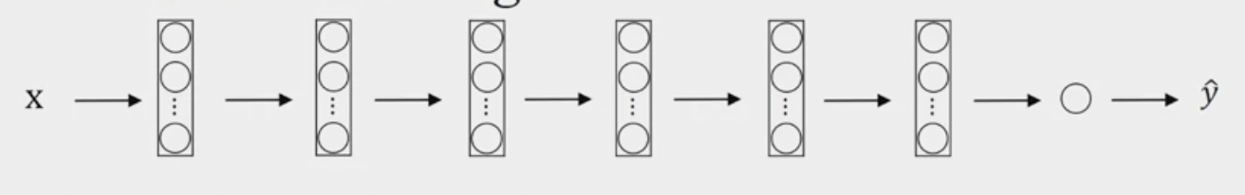
Transfer Learning
Tigger
Misty
Neither
freeze
trainable parameters = 0
freeze = 1
freeze
train

Slide 100
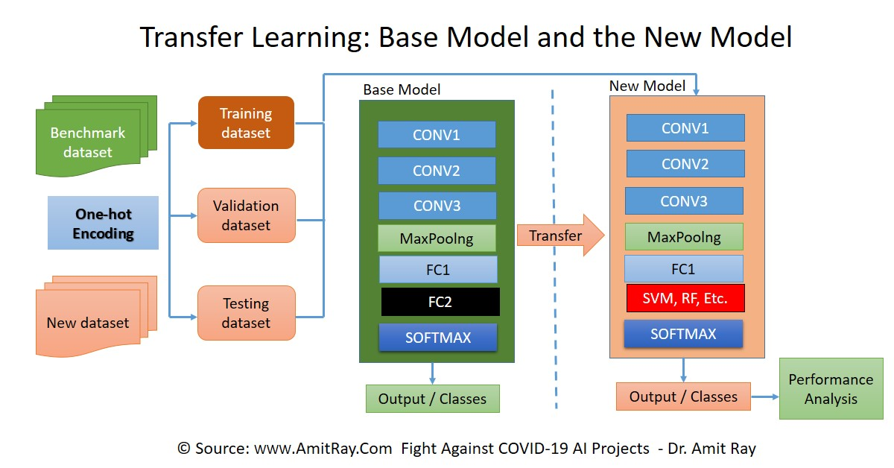

Slide 101
Practical advice for using ConvNets
Data augmentation

Slide 102
Data augmentation
Data augmentation is a technique used in machine learning and computer vision to artificially increase the size of a dataset by applying various transformations to the original data.
The goal is to create new and diverse examples that can help improve the performance and generalization of a machine learning model.
Common data augmentation techniques include flipping, rotating, scaling, cropping, adding noise, changing brightness and contrast, and applying various filters. By applying these transformations, the model is exposed to a wider range of inputs, which can help it learn to recognize patterns and variations in the data more effectively.
Random cropping is another common technique where different random crops of the dataset are taken to create new examples. In addition, color shifting can be used to introduce different color distortions to the image, making the model more robust to changes in lighting conditions.

Slide 103


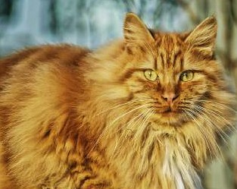
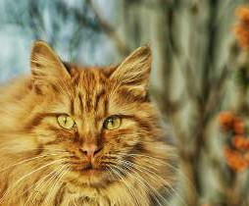

Common augmentation method
Mirroring
Random Cropping
Rotation
Shearing Local warping
…

Slide 104
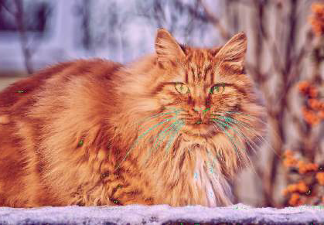
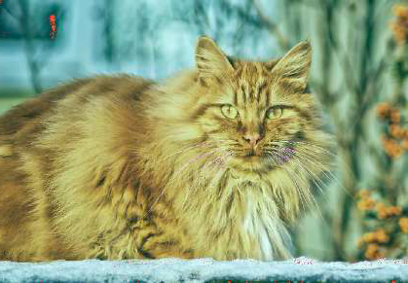
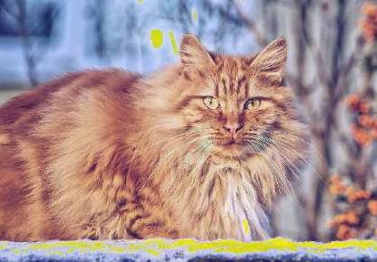
Color shifting
+20,-20,+20
-20,+20,+20
+5,0,+50

Slide 105
Implementing distortions during training
To implement data augmentation, one can use a CPU thread to constantly load images from the hard disk and apply distortions to each image before passing it to another thread or process responsible for training the deep neural network. Hyperparameters such as the amount of color shifting or the specific parameters for random cropping can be adjusted to capture more invariances and improve the model's performance.
In general, using someone else's open-source implementation for data augmentation is a good place to start, but it may also be necessary to fine-tune hyperparameters for specific applications.

Slide 106
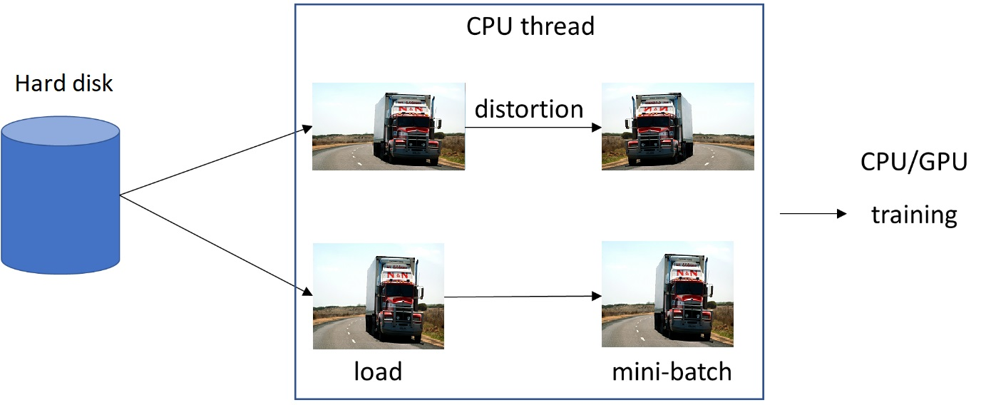
Implementing distortions during training

Slide 107
Practical advice
for using ConvNets
The state of
computer vision

Slide 108
The state of computer vision
Deep learning has been successfully applied to various fields, including computer vision, natural language processing, speech recognition, online advertising, logistics, and more.
However, computer vision is unique in the sense that it requires a lot of data to train a model due to the complexity of the problem. Even with large datasets, it feels like there's still not enough data to train a good model for computer vision, and therefore, hand-engineering is often necessary to get good performance.

Slide 109
Data vs. hand-engineering
The two sources of knowledge for a learning algorithm: labeled data and hand-engineering.
When there is little labeled data, more hand-engineering is required to get good performance.
However, when there is a lot of data, simpler algorithms can be used, and less hand-engineering is needed.

Slide 110
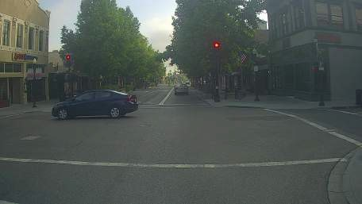
Data vs. hand-engineering
Little data
Lost of data
Model had-engineering
Objective detection
Image recognition
Speech recognition
Simpler algorithms
Little data
Transfer learning
Two sources of knowledge
Labeled data
Hand engineered features/network architecture/other components

Slide 111
Tips for doing well on benchmarks/winning competitions
There is a lot of emphasis in the computer vision community on doing well on standardized benchmark datasets and winning competitions. To achieve better performance on these benchmarks, people often use techniques like ensembling (averaging the outputs of multiple independently trained neural networks) and multi-crop at test time (applying data augmentation to the test image). While these techniques are useful for winning competitions, they may not be practical for real-world applications.
Using someone else's pre-trained model and fine-tuning it on your dataset to get started quickly on an application, especially if you have limited compute resources. However, if you have the resources and inclination, training your own networks from scratch may be necessary to invent your own computer vision algorithm.

Slide 112
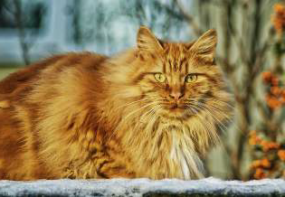
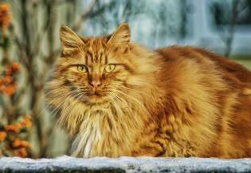
Tips for doing well on benchmarks/winning competitions
Ensembling
Train several networks independently and average their outputs
Multi-crop at test time
Run classifier on multiple versions of test images and average results

Slide 113
Use open source code
Use architectures of networks published in the literature
Use open source implementations if possible
Use pretrained models and fine-tune on your dataset

Slide 114
Summarization
Classic networks like LeNet, AlexNet, and VGG laid the foundation for modern CNNs.
ResNets address the vanishing gradient problem using residual connections.
Network in Network utilizes 1×1 convolutions for enhanced model capacity.
Inception networks capture information at multiple scales using diverse convolutions.
MobileNet, optimized for mobile devices, employs depthwise separable convolutions.
EfficientNet achieves efficiency through compound scaling.
Transfer learning leverages pre-trained models for new tasks, reducing training time.
Data augmentation enhances model generalization by applying diverse transformations.
The current state of computer vision includes self-supervised learning and real-time applications, showcasing advancements and challenges.
Notes:
Why Look at Case Studies?
Case studies provide practical insights, showcasing real-world applications of techniques and architectures. They offer valuable learning experiences and help in understanding the nuances of implementing models in various contexts.
Classic Networks:
Refers to early deep learning architectures like LeNet, AlexNet, and VGG, which laid the foundation for modern convolutional neural networks.
Residual Networks (ResNets):
Introduces the concept of ResNets, which utilize residual connections to address the vanishing gradient problem in deep networks, allowing the training of extremely deep models.
Why ResNets Work:
ResNets work by introducing shortcut connections that enable the direct flow of gradients during backpropagation, facilitating the training of deep networks without degradation in performance.
Network in Network and 1×1 Convolutions:
Discusses the Network in Network concept, which uses 1×1 convolutions to enhance model capacity and learn intricate patterns within local regions of the input data.
Inception Network Motivation:
Describes the motivation behind Inception networks, which aim to capture information at multiple scales by using various sizes of convolutions and pooling operations.
Inception Network:
Introduces the Inception architecture, characterized by its innovative use of parallel convolutional operations with different kernel sizes and strides, maximizing information extraction.
MobileNet:
Introduces MobileNet, a lightweight neural network architecture optimized for mobile and edge devices, achieved through depthwise separable convolutions, reducing computational complexity.
MobileNet Architecture:
Outlines the architecture of MobileNet, emphasizing its efficient use of operations, making it suitable for real-time applications on resource-constrained devices.
EfficientNet:
Describes EfficientNet, a scalable and efficient architecture achieved through compound scaling, balancing model depth, width, and resolution for optimal performance.
Transfer Learning:
Transfer learning involves using pre-trained models on new tasks, leveraging knowledge learned from vast datasets. It boosts performance and reduces training time for specific tasks.
Data Augmentation:
Data augmentation involves applying various transformations to training data, such as rotation, flipping, or scaling, creating diverse samples to enhance model generalization.
The State of Computer Vision:
Provides an overview of the current landscape of computer vision, showcasing advancements, challenges, and emerging trends, such as self-supervised learning and real-time applications.

